Slide 1

Decoding Gross Incurred Costs
C.S. Group present for Macquarie University's AI Challenge for Navigator Group"
Team Member:
Jasmine Huynh
Rawan Odeh
Sapna Pinnapola
Anas

Slide 2
TABLE OF CONTENTS
01
02
03
04
Problem Description
Data Exploration
Applied predicted and our results
Imputing missing values

Slide 3
01
Problem Description

Slide 4
Problem Statement
OUR PROBLEM
How can we accurately predict the "gross incurred cost" of workers compensation claims using machine learning and artificial intelligence models, based on psychosocial and demographic data provided in the dataset?

Slide 5

Problem Statement
OUR AIM & METHODOLOGY
Extensively apply a diverse range of machine learning and artificial intelligence models (regression model) to our dataset, with the specific objective of identifying the model that yields the lowest Root Mean Square Error (RMSE): which is the average squared differences between predicted and actual costs
By pinpointing the most accurate predictive model through this metric, we intend to adopt it for future applications and forecasting related to the "gross incurred cost" of workers' compensation claims.
1. economic forecasting (insurance selling price).
2. strategies that can better manage the psychosocial determinants affecting these insurance claims.

Slide 6
02
Data Exploration

Slide 7
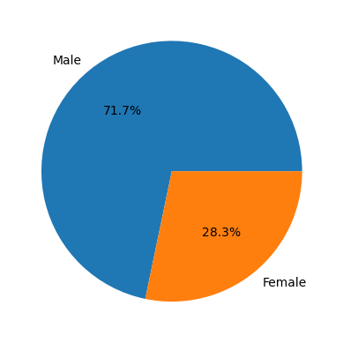
02. Data Exploration
We found that there were far more males in the dataset than females.
391 Males
156 Females

Slide 8
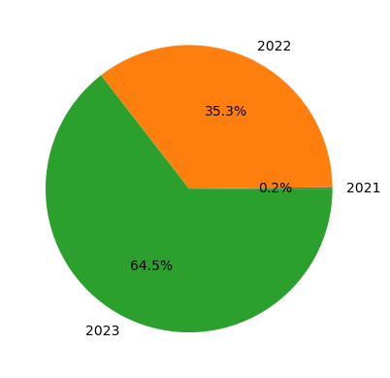
02. Data Exploration
The majority of claims were finalised in 2023. 2021 had an extremely low amount of claims. This may point to claims taking too long to finalise.

Slide 9
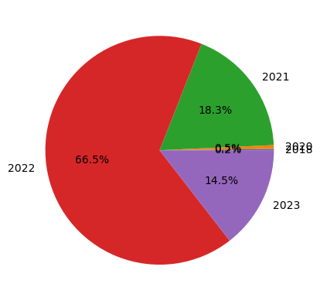
02. Data Exploration
The most accidents occurred in 2022 by far, with 2021 and 2023 were similar to one another.

Slide 10
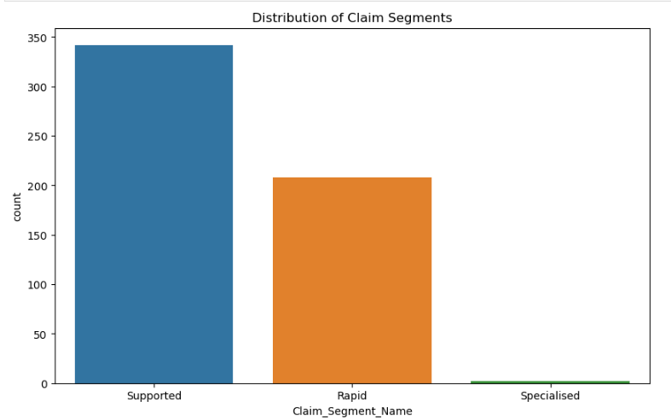

Slide 11
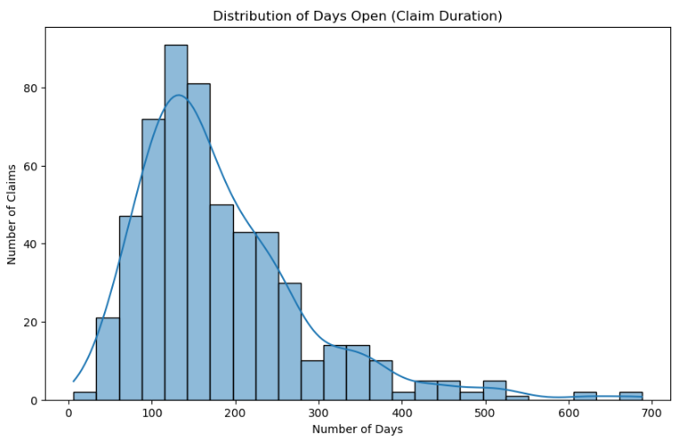

Slide 12
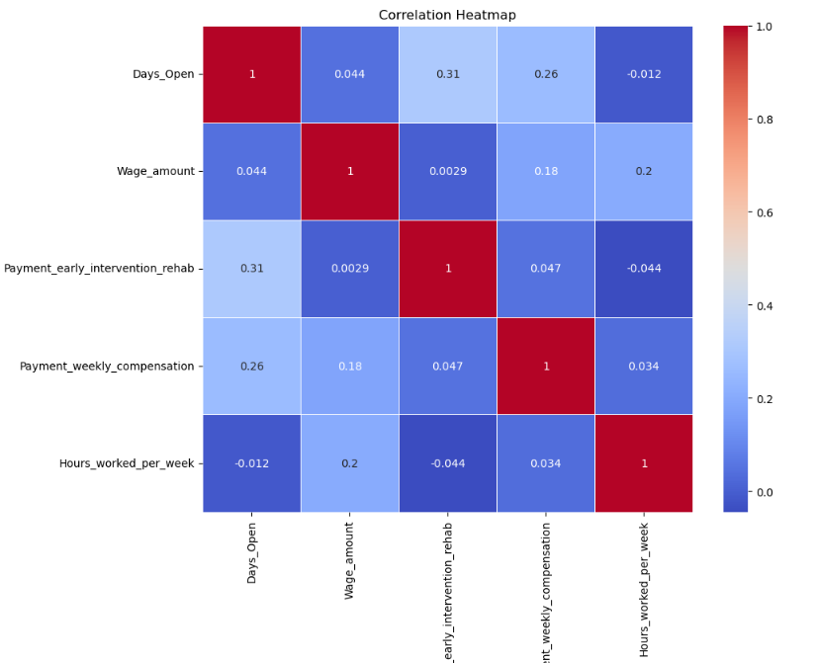

Slide 13
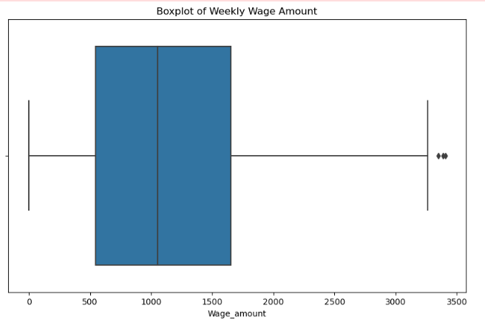

Slide 14
03
Inputting missing values

Slide 15
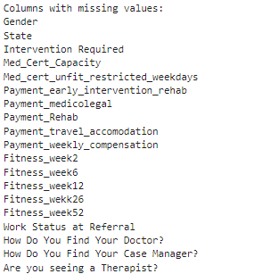
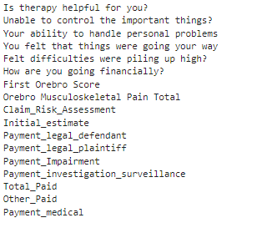
03. Inputing missing values
From 71 we have 36 columns with missing values

Slide 16
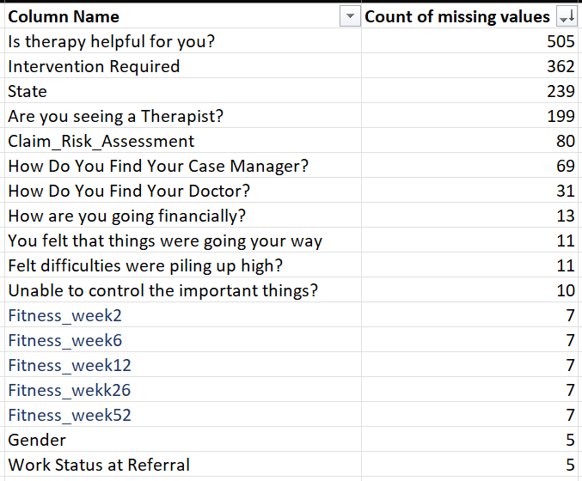
03. Inputing missing values
From 71 we have 36 columns with missing values

Slide 17
03. Inputing missing values
Our methods:
Identify most occurring values for all categorical variables and replace missing values with it.
Identified one row with multiple missing values, so it was considered as an outlier and deleted.
Used mean to replace missing values for numerical variables. (E.g.- First Orebro Score)
Used K-nearest neighbour model to input missing value for Orebro Musculoskeletal Pain Total.

Slide 18
04
Applied predictted models and our results

Slide 19
Machine Learning Models
Linear Regression
Linear Regression
with RFE
Model assumes a linear relationship between the predictor variables and the target variable
Machine learning technique used for feature selection and regression analysis. It combines linear regression, a simple yet powerful regression algorithm, with RFE, a feature selection method.

Slide 20
Machine Learning Models
Random Forest
Decision
Tree
Multi Layer
Neural Network
Modelling technique that combines multiple decision trees to improve prediction accuracy and reduce overfitting.
Can capture complex relationships in the data by recursively partitioning the feature space. It's especially useful when there are nonlinear and interaction effects in the data.
Artificial neural network (ANN) composed of multiple layers of interconnected nodes or neurons.

Slide 21
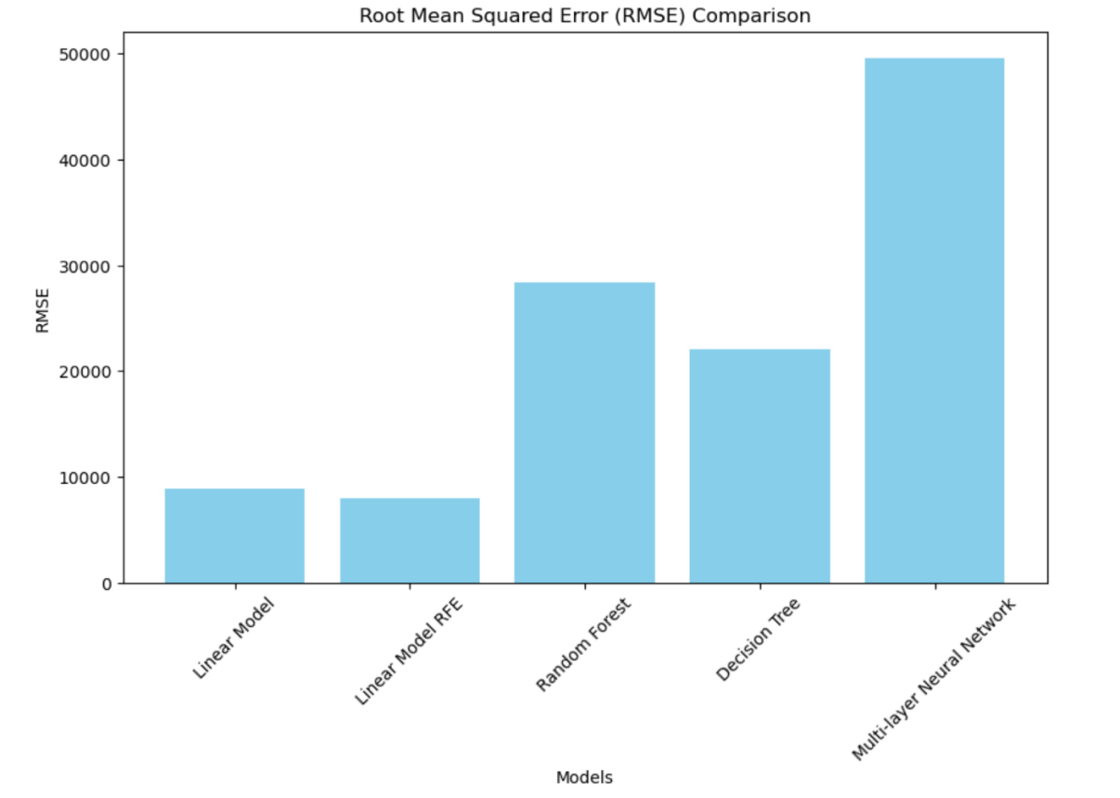
Results
RMSE
Linear Model: 8902.99
Linear Model RFE: 8012.87
Random Forest: 28451.09602405962
Decision Tree: 22056.757638082927
Multi-Layer Neural Network: 49608.97600627856

Slide 22
Our recommendations

Slide 23
THANKS!
Do you have any questions?
Please keep this slide for attribution

